Slide 1
How can we use previous optic nerve regeneration literature to discover novel promoters and inhibitors?

Slide 2
Find a collection of sentences that refer to promotion, sentences that refer to inhibition, and sentences that refer to neither in our corpus
Train a state-of-the-art NLP model to learn which sentences refer to promotion, which sentences refer to inhibition, and which sentences refer to neither
Use this model on sentences in our corpus that have a molecule to learn if that molecule is a promoter, inhibitor, or neither

Slide 3
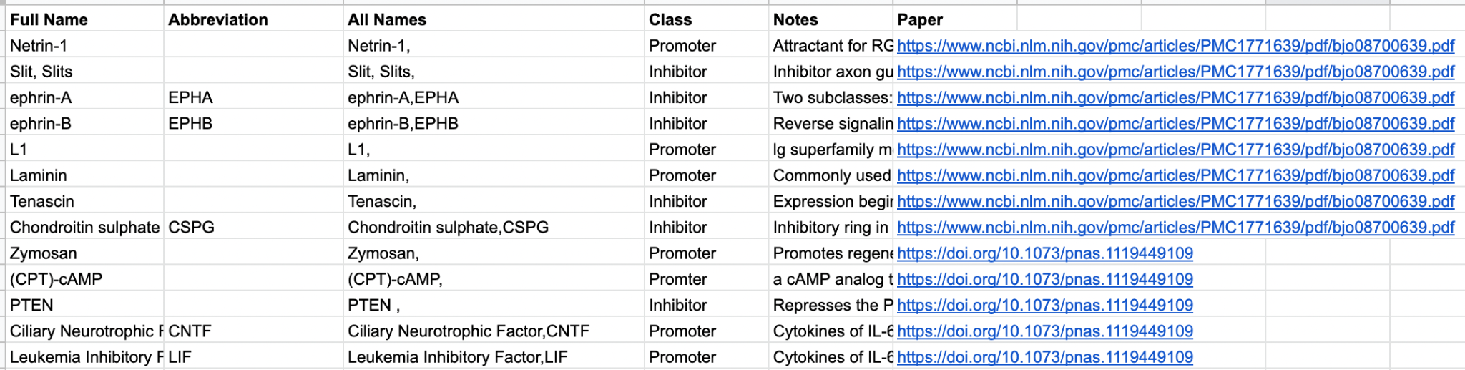
Find a collection of sentences that refer to promotion, sentences that refer to inhibition, and sentences that refer to neither in our corpus
To do this get known promoters and inhibitors from research papers
14 promoters and 13 inhibitors used

Slide 4
Find a collection of sentences that refer to promotion, sentences that refer to inhibition, and sentences that refer to neither in our corpus
Using these molecules, we went through our corpus and collected sentences with a promoter (positive samples), sentences with an inhibitor (negative samples) and sentences with neither (neutral samples)
We found 1,279 sentences with only promoters, 2631 sentences with only inhibitors and used 5000 sentences with neither
*Sentences with both promoters and inhibitors were excluded from training

Slide 5
2. Train a best-in-class NLP model to learn which sentences refer to promotion, which sentences refer to inhibition, and which sentences refer to neither
BERT is an NLP model released by Google in 2018 that is now industry standard
It was trained on massive piles on unannotated text on the web meaning it already understands a lot about grammar, syntax, etc…
We then “fine-tuned” this model on our positive, negative, and neutral samples to teach it how to recognize sentences as promotory, inhibitory, or neither

Slide 6
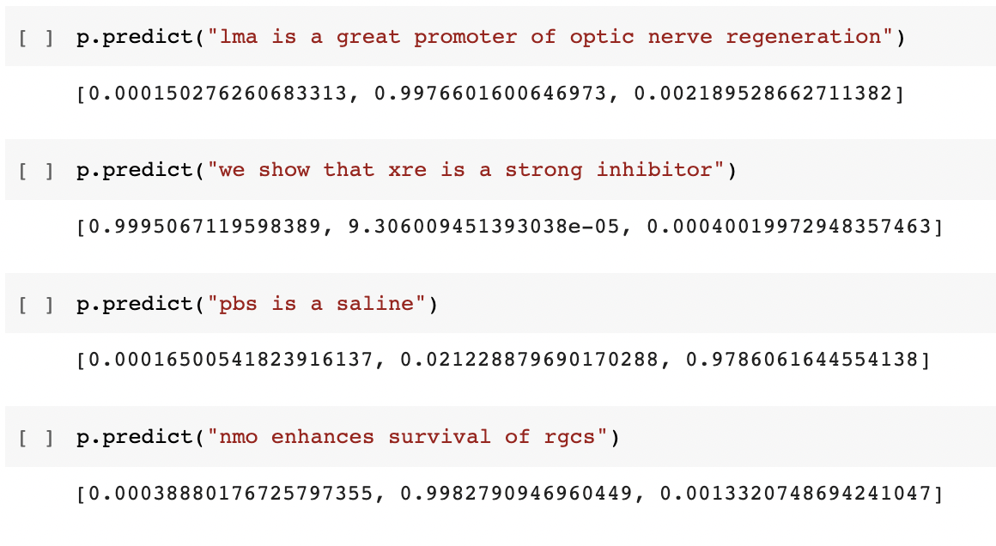
2. Train a best-in-class NLP model to learn which sentences refer to promotion, which sentences refer to inhibition, and which sentences refer to neither

Slide 7
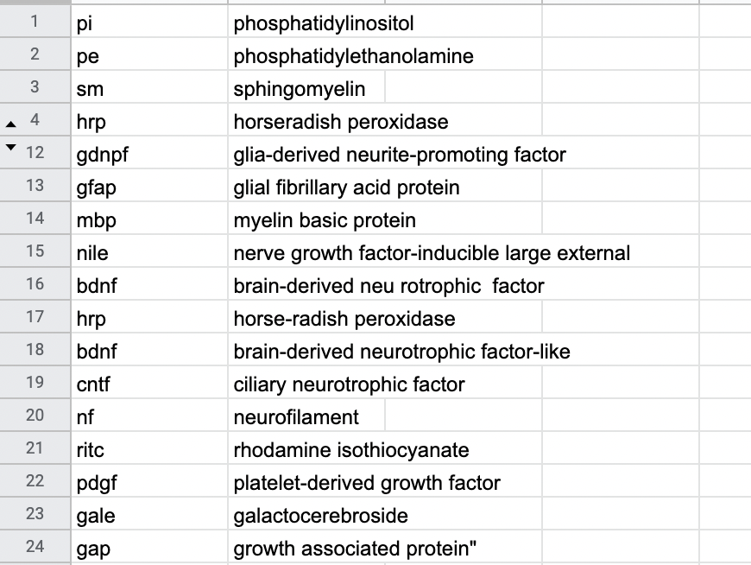
3. Use this model on sentences in our corpus that have a molecule to learn if that molecule is a promoter, inhibitor, or neither
Extract molecules from our corpus using an Abbreviation Detector Algorithm

Slide 8
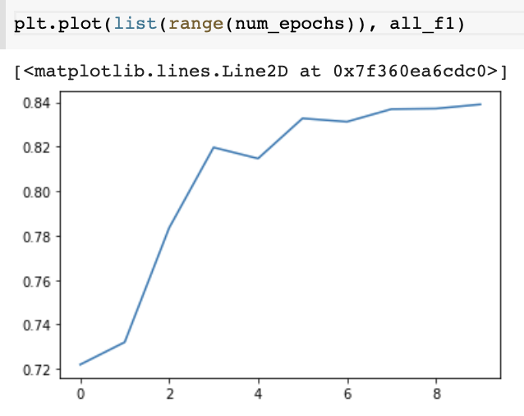
3. Use this model on sentences in our corpus that have a molecule to learn if that molecule is a promoter, inhibitor, or neither

Slide 9
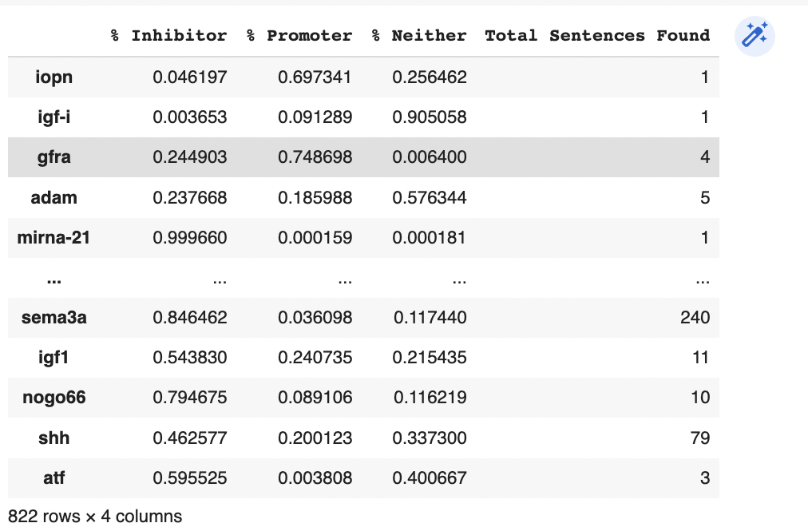
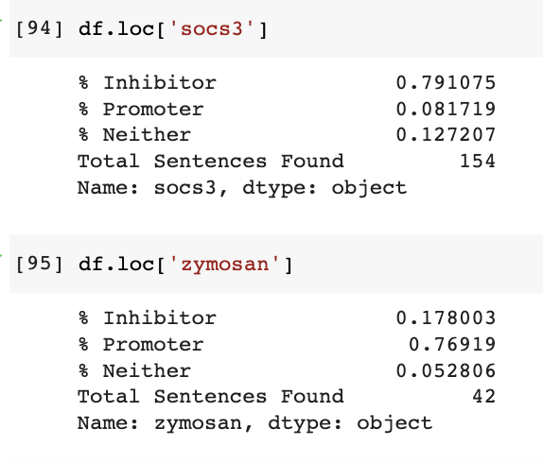
3. Use this model on sentences in our corpus that have a molecule to learn if that molecule is a promoter, inhibitor, or neither
We then can use BERT to predict the labels of the 822 molecules discovered

Slide 10
Main Takeaways
We developed a way to classify molecules from optic nerve regeneration literature spanning from 1776 - 2015 using a state-of-the-art NLP model
Notably, these scores are probabilities meaning a molecule could be labeled as 60% promoter and 40% inhibitor
This model allows the determination of molecules that could be used for future study, confirm pre-existing findings, etc…

Slide 11
Further Questions to Answer
Determine accuracy through wet lab team labeling true state of molecule (promoter, inhibitor, neither)
Do molecules that are in less sentences have less accuracy?
Do molecules from papers in earlier years have less accuracy?
Do certain types of sentences lead to molecules with less accuracy?
Etc…

Slide 12
How can we use previous optic nerve regeneration literature to discover novel pathways?

Slide 13
Represent molecules in a way that holds meaning
Link molecules together in a meaningful way into a graph format
Determine pathways from this graph

Slide 14
1. Represent molecules in a way that holds meaning
Word2Vec is an algorithm that allows us to represent molecules as a list of numbers
These numbers hold meaning in relation to each other
It uses a neural network approach to train these representations of words

Slide 15
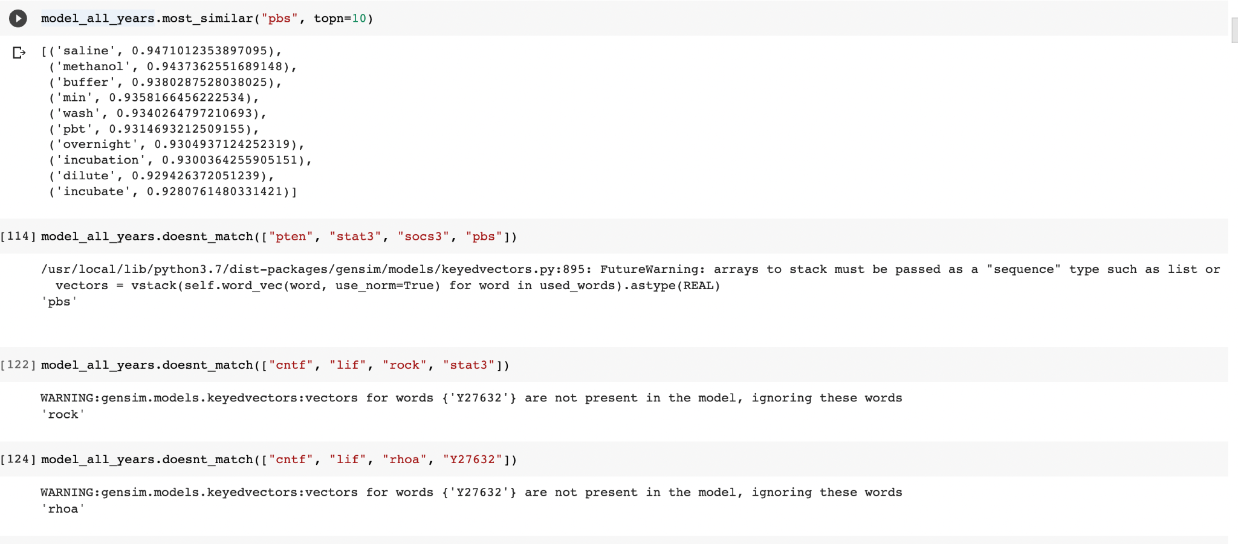
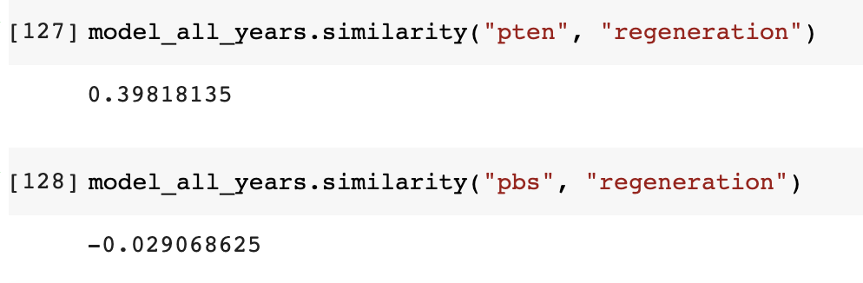
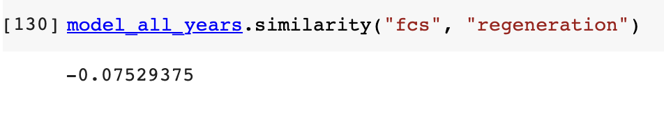
1. Represent molecules in a way that holds meaning
Notes:
Word2Vec Model looks pretty robust

Slide 16
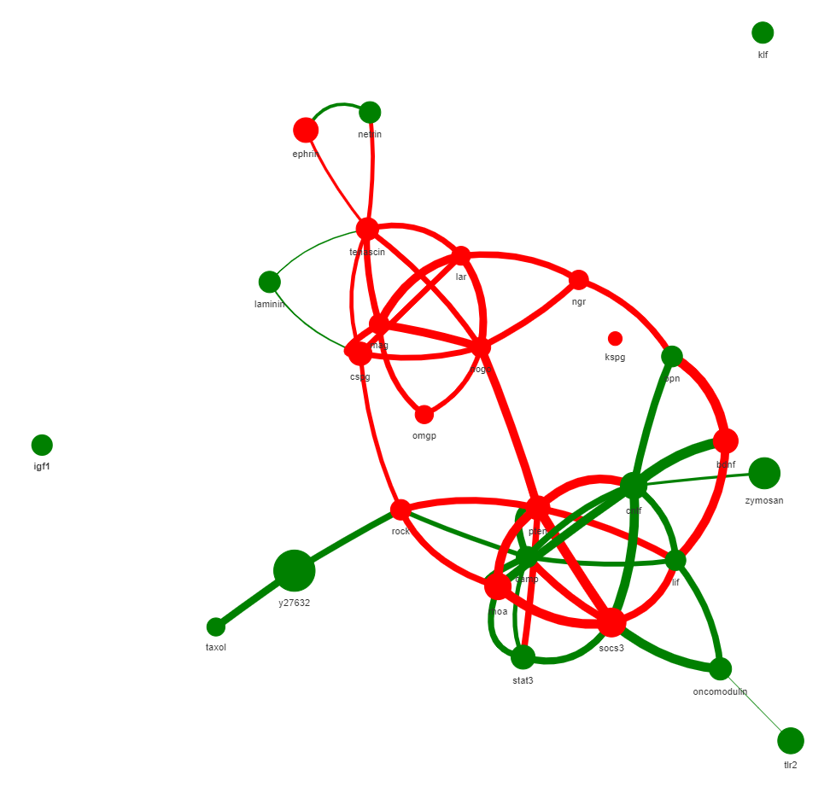
2. Link molecules together in a meaningful way into a graph format
These are linked by whether molecules occur in the same sentence or not

Slide 17
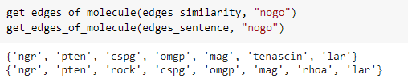
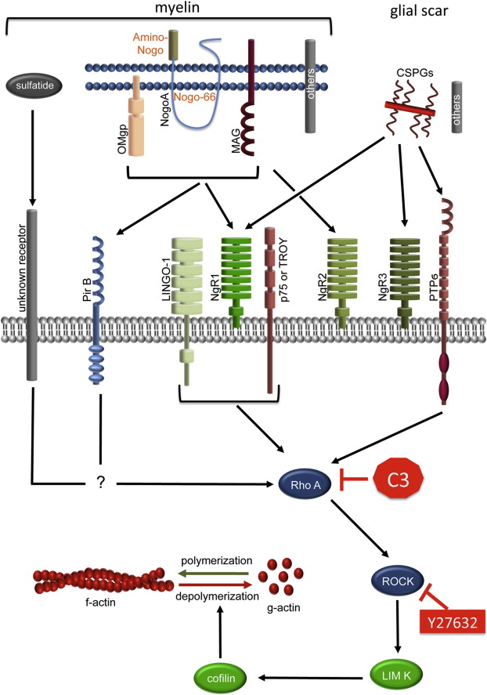

Slide 18
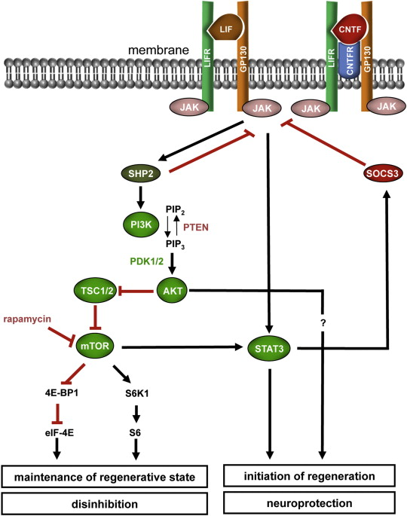
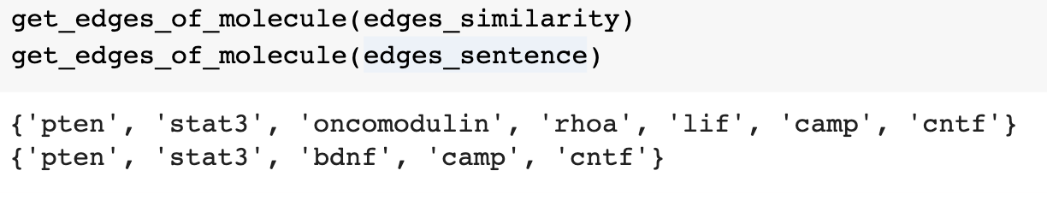
keyword=”socs3”

Slide 19
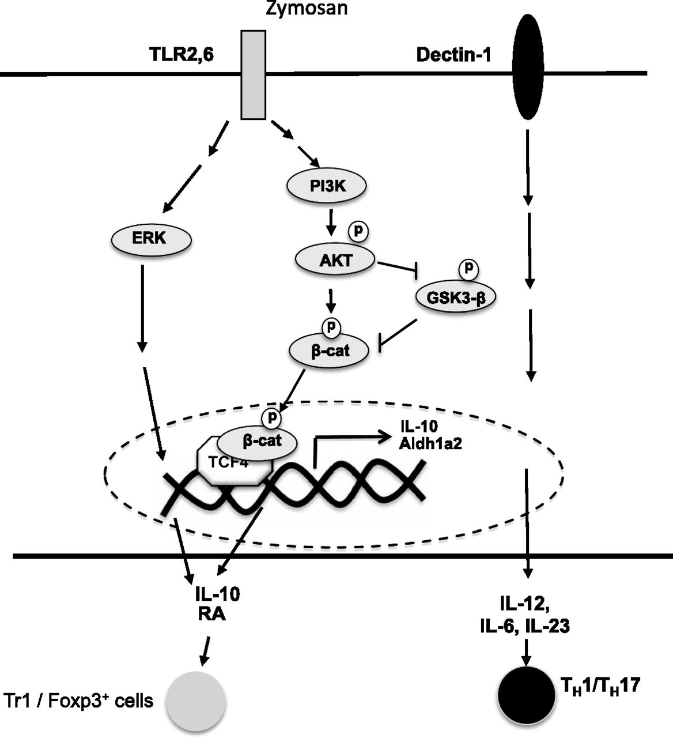
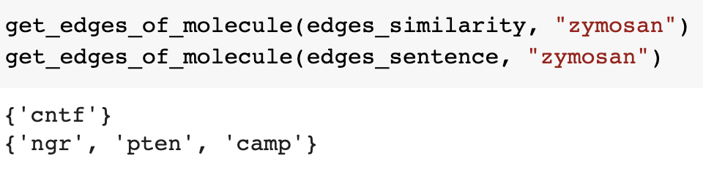

Slide 20
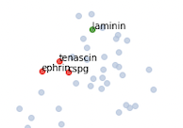
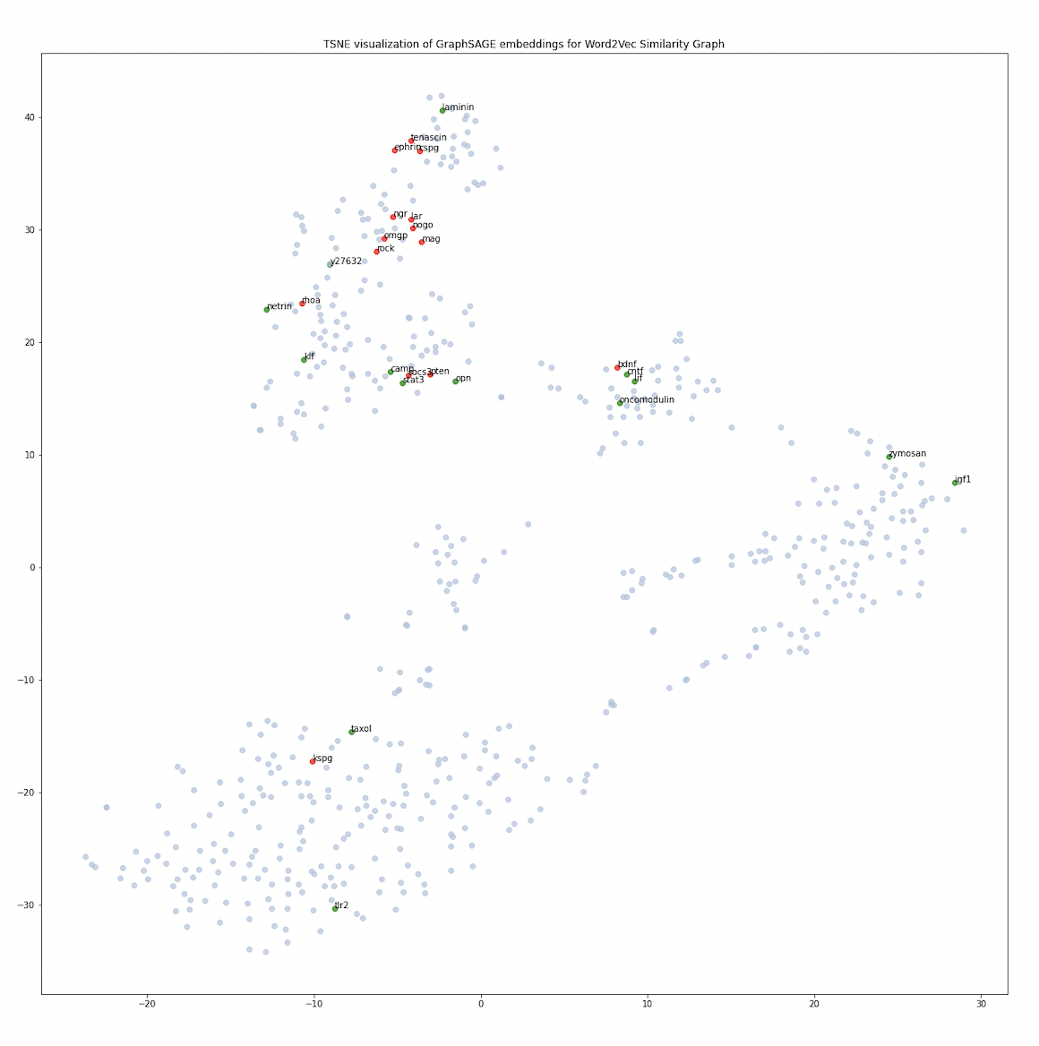
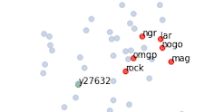
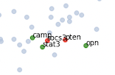
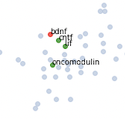
You can see it’s clustering on pathways
Seed = 99
Features = Corpus-trained Gensim Word Embeddings
Samples = 10
Links = Same Sentence
Epochs = 10
Strength = N/A

Slide 21
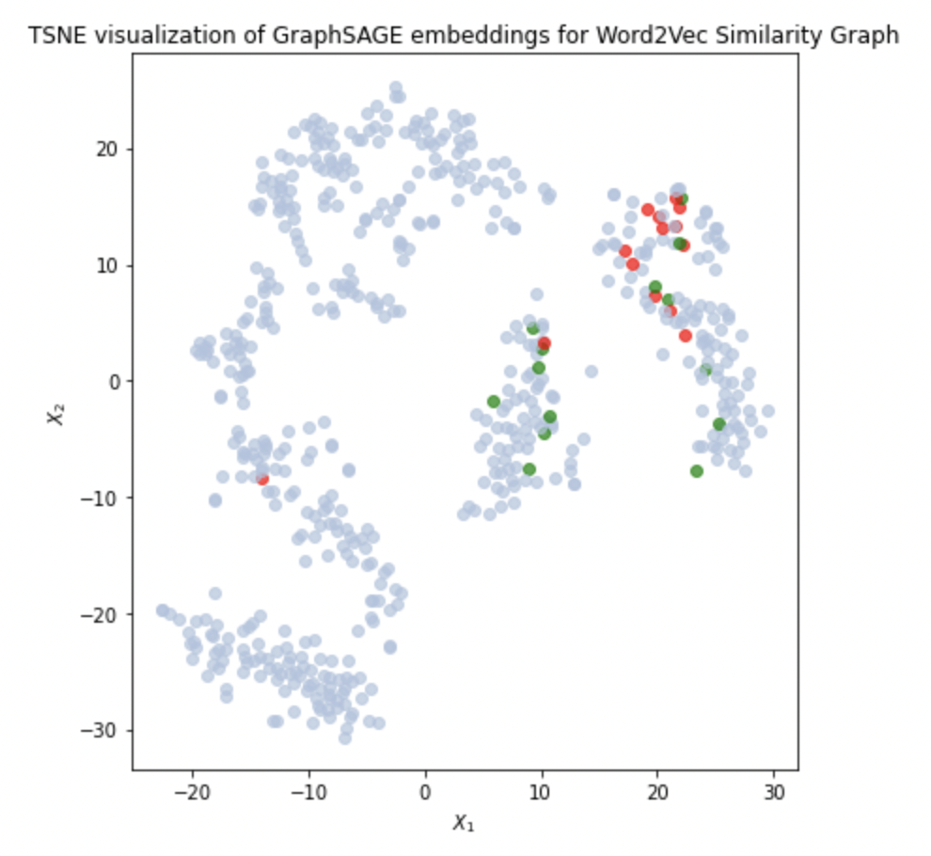
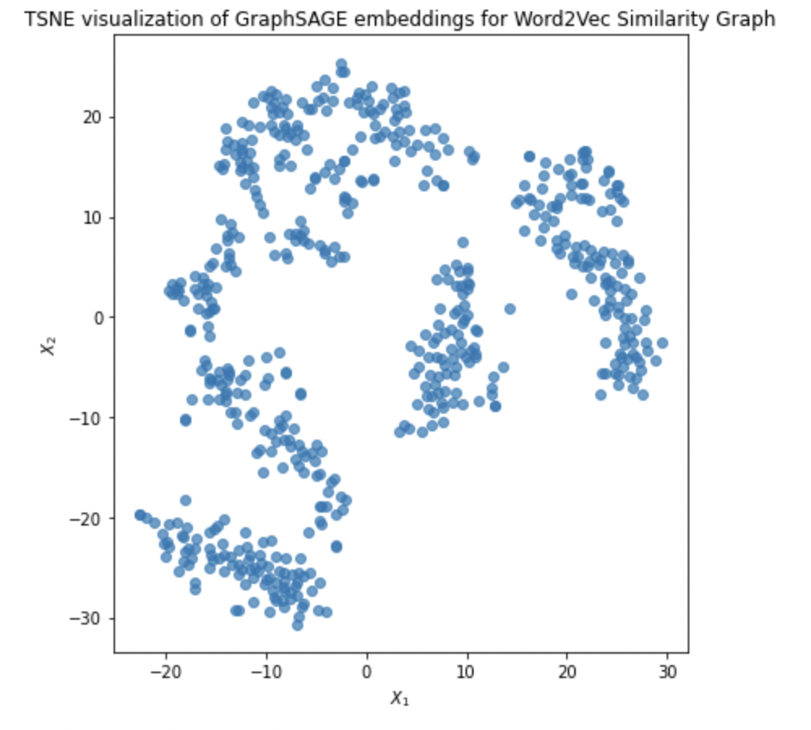
Features = Corpus-trained Word Embeddings
Samples = 10
Links = WordVec Simil
Epochs = 10
Strength = N/A
Notes:
Notice how top 3 molecules are the same for all 3

Slide 22
Main Takeaways
We developed a way to determine pathways from optic nerve regeneration literature in an unsupervised manner
Unsupervised means there was no manual labeling of molecules needed - significantly reducing the work and making it easily extrapolable to other fields
This model allows the determination of new pathways, molecule interactions, and further research questions

Slide 23
